Slide 1
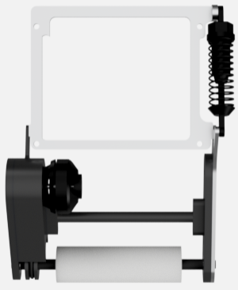
IR sensor
Sub CPU
TSSP58038
Arduino Nano Every
Gyro sensor
Main CPU
Dribbler
ESC
BNO055
Arduino MEGA
Motor
Motor Driver
Line sensor
Palolu 25D
20.4:1 12V
DRV8835
NJL7502R
UART
I2C
PWM
Digital
Analog

